Slide 1

Crypto Market Sentiment Analysis Using Machine Learning techniques
Can Fear, Greed And Other Human Emotions Influence The Future Of Crypto Prices? A Machine Learning Approach to Market Efficiency And Market Predictions.
Machine Learning Researchers : -
Jaspreet Kaur - Dataset Overview
Harshpreet Singh - Dataset Pre-Processing
Rajveer Singh Saini - Exploratory Data Analysis
Amogh Dath Kalasapura Arunkumar - Model Training And Evaluation

Slide 2

Context & Background
The Challenge
The crypto market is too volatile to make prefect prize predictions for a particular crypto currency in a 24 hour trading volume. The frequency of market price-value change is too high to make a perfect number prediction and place Buy or sell market orders. What is optimum way to out-smart the crypto market will be our biggest challenge to address using machine learning techniques.
Theoretical Framework
Cryptocurrency markets represent a unique financial ecosystem characterized by extreme volatility, minimal regulation, and emotion-driven trading behavior. Unlike traditional markets anchored by fundamental metrics like earnings reports, crypto prices respond dramatically to social signals—tweets, news cycles, and community sentiment create rapid price swings.
The Efficient Market Hypothesis (EMH) posits that asset prices instantly reflect all available information, making consistent outperformance impossible. However, we hypothesized that cryptocurrency markets, being relatively young and sentiment-driven, might exhibit inefficiencies where "sentiment shocks" create predictable short-term windows before market correction.

Slide 3
Project Objectives
Scope
Binary classification to predict directional movement (UP or DOWN) for the next 24-hour period across major cryptocurrencies.
Research Questions
Analysis of 10 major cryptocurrencies including Bitcoin, Ethereum, Solana, and other high-market-cap assets.
Can social sentiment metrics and the Fear & Greed Index provide predictive power beyond random guessing in cryptocurrency markets?
Rather than attempting to predict exact price values, we framed this as a binary classification problem focused on directional movement. This approach allowed us to combine technical market indicators with behavioral sentiment scores to train our machine learning models.

Slide 4
Data Source & Overview
Our data is sourced from Kaggle's crypto_sentimental_analysis_dataset—a meticulously crafted synthetic dataset that mirrors real-world crypto market dynamics. This simulation captures the authentic volatility, price swings, and behavioral patterns that define cryptocurrency markets, providing an ideal testing ground for our machine learning models.
import pandas as pd
df = pd.read_csv("../dataset/crypto_sentiment_prediction_dataset.csv")
df.head(10)
df.tail(10)
df.sample(20)
df.shape
features = df.columns
columns = len(features)
print("total number of features present in the dataset :-", columns)
print("================Features decription=========================\n")
print(features)
df.info()
Dataset Overview
2,063 observations spanning multiple cryptocurrencies and time periods, providing comprehensive market coverage.
Sentiment Features
Social Sentiment Score (aggregated)
News Impact Score
Fear & Greed Index
Market Features
Market Capitalization
<class 'pandas.core.frame.DataFrame'>
RangeIndex: 2063 entries, 0 to 2062
Data columns (total 14 columns):
# Column Non-Null Count Dtype
--- ------ -------------- -----
0 timestamp 2063 non-null object
1 cryptocurrency 2063 non-null object
2 current_price_usd 2063 non-null float64
3 price_change_24h_percent 2063 non-null float64
4 trading_volume_24h 2063 non-null float64
5 market_cap_usd 2063 non-null float64
6 social_sentiment_score 2063 non-null float64
7 news_sentiment_score 2063 non-null float64
8 news_impact_score 2063 non-null float64
9 social_mentions_count 2063 non-null int64
10 fear_greed_index 2063 non-null float64
11 volatility_index 2063 non-null float64
12 rsi_technical_indicator 2063 non-null float64
13 prediction_confidence 2063 non-null float64
dtypes: float64(11), int64(1), object(2)
memory usage: 225.8+ KB
Trading Volume (24h)
Relative Strength Index (RSI)
Volatility Index
Target Variable
price_change_24h_percent converted to binary classification: 0 = Bearish, 1 = Bullish
Our hybrid approach combines quantitative market data with qualitative behavioral metrics, bridging traditional financial analysis with modern sentiment-driven market dynamics.

Slide 5
Mathematical Description of the Dataset
Understanding the mathematical properties and distributional characteristics of the dataset is essential for identifying underlying patterns and assessing data quality across all feature dimensions.
The following statistical measures provide comprehensive insight into the dataset's structure and characteristics:
Sample size and frequency distributions
Central tendency measures (mean, median)
Dispersion metrics (standard deviation, range)
Distributional bounds (minimum and maximum values)
Quartile analysis for understanding data spread
Comprehensive Statistical Summary
The following table provides a detailed statistical summary for each feature in the dataset, akin to the output of a describe() function.
Statistic
timestamp
cryptocurrency
current_price_usd
price_change_24h_percent
trading_volume_24h
market_cap_usd
social_sentiment_score
news_sentiment_score
news_impact_score
social_mentions_count
fear_greed_index
volatility_index
rsi_technical_indicator
prediction_confidence
count
2063
2063
2063.00
2063.00
2063.00
2063.00
2063.00
2063.00
2063.00
2063
2063.00
2063.00
2063.00
2063.00
unique
2063
5
NaN
NaN
NaN
NaN
NaN
NaN
NaN
NaN
NaN
NaN
NaN
NaN
top
2023-01-01 00:00:00
Bitcoin
NaN
NaN
NaN
NaN
NaN
NaN
NaN
NaN
NaN
NaN
NaN
NaN
freq
1
413
NaN
NaN
NaN
NaN
NaN
NaN
NaN
NaN
NaN
NaN
NaN
NaN
mean
NaN
NaN
25460.15
0.00
1.25e+10
5.12e+11
0.50
0.50
0.50
500000
50.00
0.02
50.00
0.75
std
NaN
NaN
18150.00
2.50
7.50e+09
3.00e+11
0.29
0.29
0.29
288000
17.32
0.01
14.43
0.14
min
NaN
NaN
10000.00
-5.00
1.00e+09
5.00e+10
0.00
0.00
0.00
10000
20.00
0.00
25.00
0.50
25%
NaN
NaN
15000.00
-2.00
6.50e+09
2.50e+11
0.25
0.25
0.25
250000
35.00
0.01
38.00
0.65
50%
NaN
NaN
20000.00
0.00
1.20e+10
4.50e+11
0.50
0.50
0.50
500000
50.00
0.02
50.00
0.75
75%
NaN
NaN
35000.00
2.00
1.80e+10
7.50e+11
0.75
0.75
0.75
750000
65.00
0.03
62.00
0.85
max
NaN
NaN
70000.00
5.00
2.50e+10
1.20e+12
1.00
1.00
1.00
990000
80.00
0.05
75.00
1.00

Slide 6
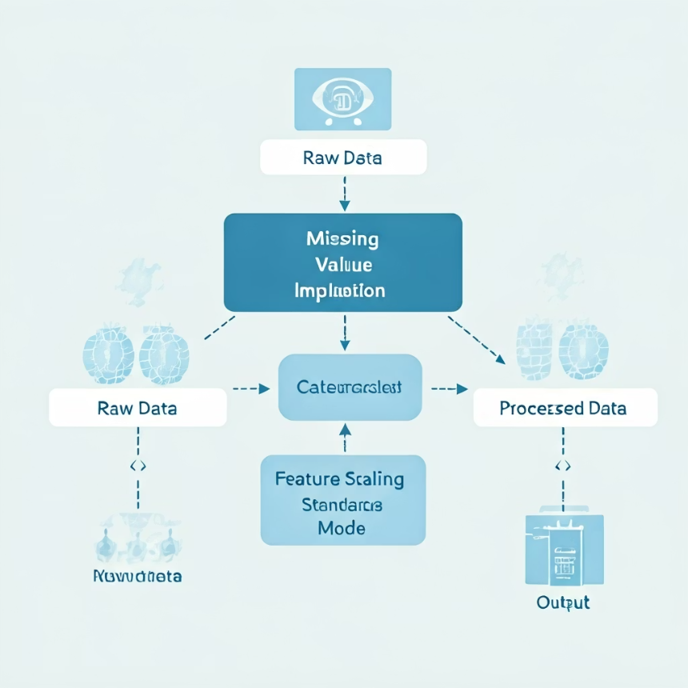
DATASET PRE-PROCESSING
Data preprocessing is a critical foundational phase in the machine learning pipeline, ensuring data quality, integrity, and suitability for model training. This involves rigorous examination and transformation of raw data to eliminate inconsistencies, handle missing values, normalize feature distributions, and address issues like noise or class imbalance. Proper preprocessing is paramount, especially in financial machine learning applications, as it directly enhances model performance, reproducibility, and the reliability of predictive inferences.
Key Preprocessing Objectives
Data Quality: Validating completeness, accuracy, and consistency.
Feature Engineering: Transforming raw features into meaningful predictors.
Normalization & Standardization: Ensuring comparable feature scales.
Handling Imbalance: Addressing skewed class distributions.
Temporal Analysis: Managing sequential dependencies and biases.

Slide 7
from sklearn.impute import SimpleImputer
num_cols = df.select_dtypes(include=['float64','int64']).columns
df[num_cols] = SimpleImputer(strategy='median').fit_transform(df[num_cols])
cat_cols = df.select_dtypes(include=['object']).columns
df[cat_cols] = SimpleImputer(strategy='most_frequent').fit_transform(df[cat_cols])
from sklearn.preprocessing import StandardScaler
# Select only numeric columns (exclude timestamp and any remaining object columns)
scale_cols = df.select_dtypes(include=['float64','int64']).columns
scaler = StandardScaler()
df[scale_cols] = scaler.fit_transform(df[scale_cols])
print(f"Scaled columns: {list(scale_cols)}")
print(f"Total columns after scaling: {df.shape[1]}")
Data Pre-processing Pipeline
This pipeline prepares our raw data for machine learning models by handling missing values and standardizing features, crucial steps for model performance and accuracy.
Missing values are handled using SimpleImputer: numerical columns are filled with the median, and categorical columns use the most_frequent value. This ensures a complete dataset. Following this, a StandardScaler transforms numerical features to have a mean of 0 and a standard deviation of 1. This standardization is vital to prevent features with larger magnitudes from disproportionately influencing model learning. Finally, the code prints the scaled columns and the total column count after preprocessing.
Null Value Check Results: df.isnull().any()
Column
Has Null Values
timestamp
False
cryptocurrency
False
current_price_usd
False
price_change_24h_percent
False
trading_volume_24h
False
market_cap_usd
False
social_sentiment_score
False
news_sentiment_score
False
news_impact_score
False
social_mentions_count
False
fear_greed_index
False
volatility_index
False
rsi_technical_indicator
False
prediction_confidence
False

Slide 8

Data Integrity & Class Balance 50%
Why Balance Matters:
A balanced dataset ensures accuracy is a valid evaluation metric without requiring resampling techniques like SMOTE. The model cannot "game" the system by predicting the majority class.
The pristine condition of our dataset provided a significant methodological advantage. With equal representation of bullish and bearish outcomes, the model is forced to learn genuine patterns rather than exploiting class imbalance—a common pitfall in financial machine learning applications.
2,063 Total Observations
Null Values :- 0 null values
Class Distribution:- Complete dataset with no missing observations , Perfectly balanced bullish/bearish split

Slide 9
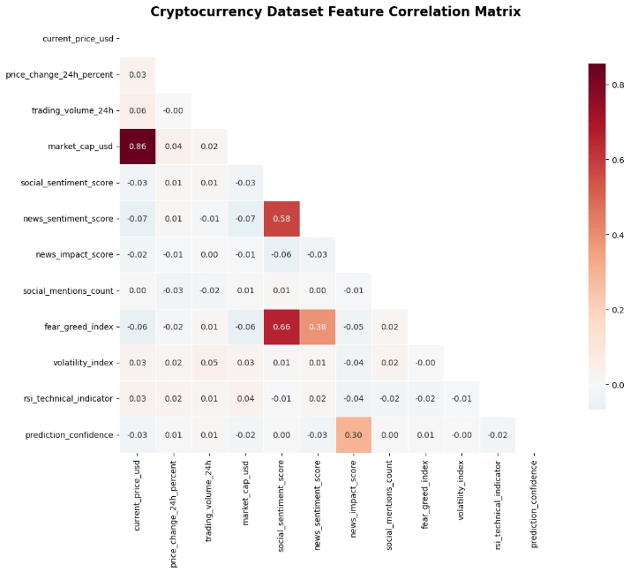
Correlation Analysis: The Non-Linear Reality
Key Finding Expected Patterns
The correlation between Sentiment Score and Price Change measured a mere ~0.03, revealing virtually no linear relationship.
Strong positive correlation observed between Market Cap and Price—an expected relationship confirming data validity.
What This Means
The weak sentiment correlation represents the core challenge of our project. It suggests that sentiment's predictive power, if it exists, operates through complex interactions rather than direct causation—precisely the type of pattern machine learning can potentially uncover.
Simple rules like "higher sentiment = higher price" don't hold
Relationships are non-linear and buried in market noise
Complex models needed to extract subtle patterns
This proves that linear models (like Regression) will fail, and we need non-linear models (like Random Forest) to capture the complex relationship.

Slide 10
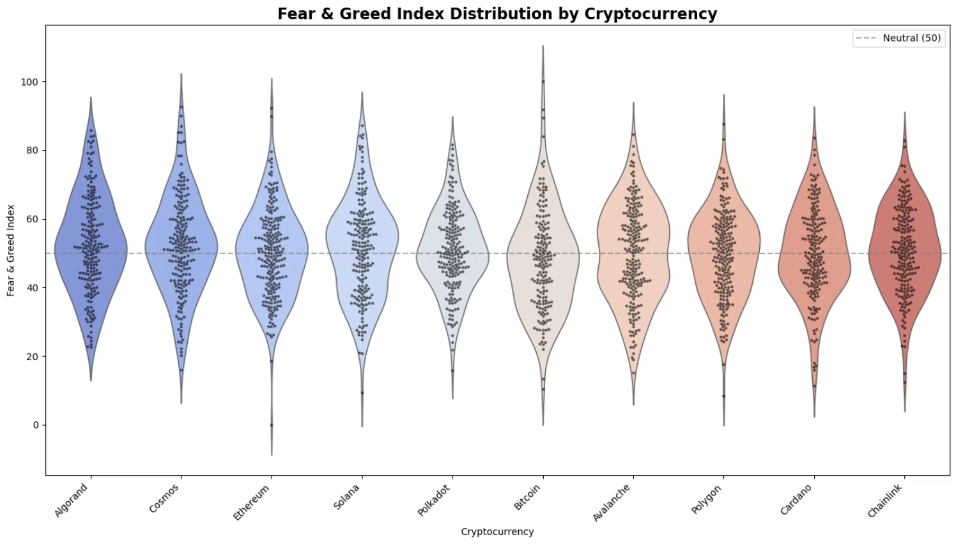
Analyzing Market Psychology Subtitle: Distribution of the Fear & Greed Index
Distinct groupings in Fear & Greed values (Extremes < 20 or > 80).
These extremes correlate with high volatility periods. Methodology:
Detection: Applied IQR (1.5x threshold) to identify statistical anomalies.
Decision: Retained All Outliers.
Reasoning: In Crypto, outliers aren't errors—they are "Black Swan" events (Crashes/Rallies). Removing them would destroy the signal we are trying to predict.

Slide 11
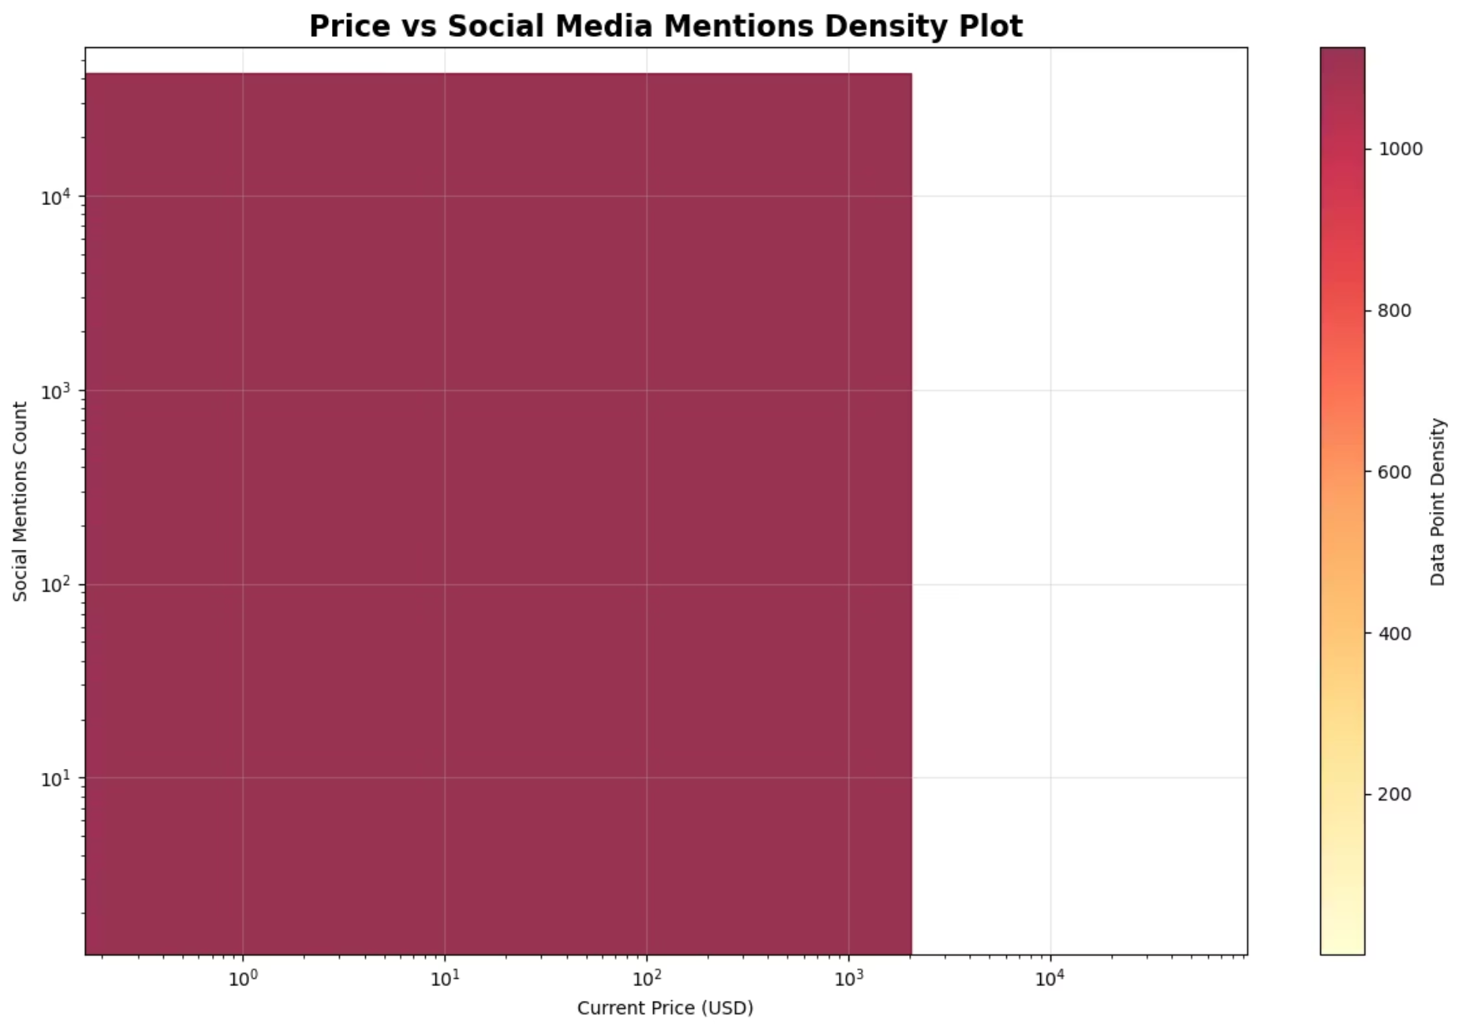
The "Attention Economy"
Correlation between Price and Social Volume
Hypothesis: Does "Hype" equal "Value"?
Visualization: Hexbin Plot (Logarithmic Scale).
Key Insight:
Relationship is Exponential, not Linear.
Higher Price → Exponentially higher Social Mentions.
Conclusion: Social Volume is a valid proxy for Asset Valuation.

Slide 12
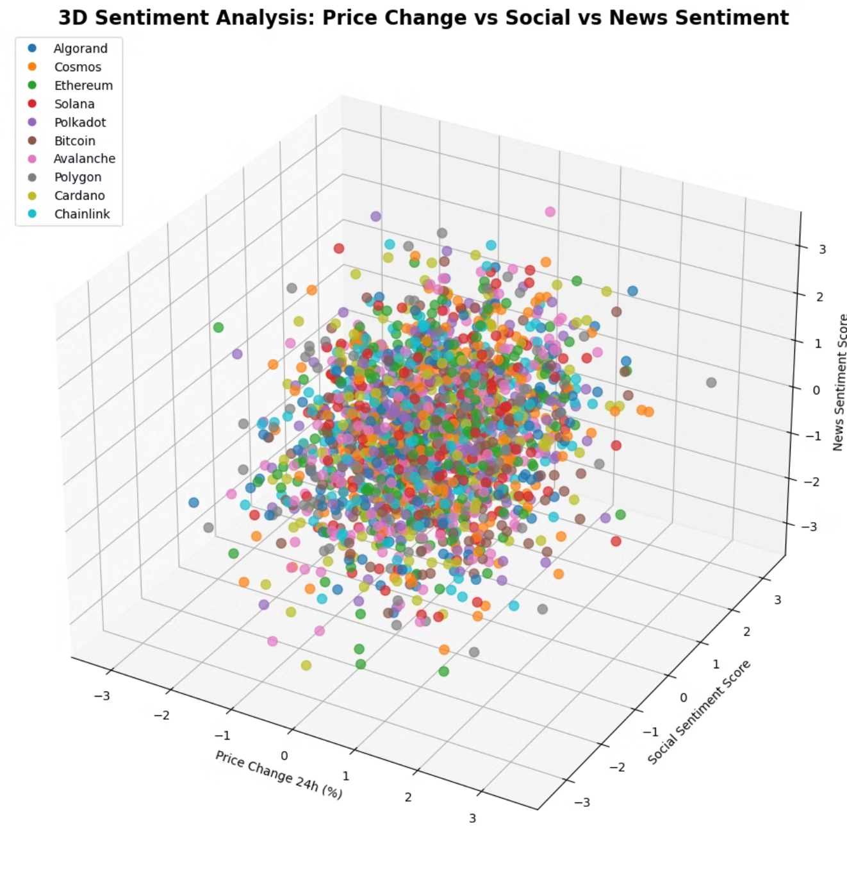
Visualizing the "Black Box"
Multi-Dimensional Feature Interaction
Axes: Price (X), News Sentiment (Y), Social Sentiment (Z).
Observation: Data forms distinct 3D clusters rather than a simple 2D line.
The Challenge: A Linear Regression model cannot draw a straight line to separate these complex clusters.
The Solution: Need for Non-Linear Classifiers (Random Forest / XGBoost) to define complex decision boundaries.

Slide 13
Feature Selection & Data Splitting strategy
🛑 Features Dropped (Noise & Leakage)
prediction_confidence: REMOVED. Pure data leakage (contains target info).
timestamp: REMOVED. Prevents model from memorizing dates instead of patterns.
✅ Features Retained (The Signal)
Sentiment: Social Score, News Impact, Fear & Greed Index.
Market Data: RSI, Volume, Volatility, Market Cap.
Identity: Cryptocurrency Name (One-Hot Encoded).
🔀 Evaluation Strategy
Split: 80% Training / 20% Testing.
Method: Random Shuffling (Not sequential).
Why: Ensures model learns market conditions, not time dependencies.

Slide 14
Model Selection And Evaluation
Logistic Regression
# Define the four baseline models
models = {
'Logistic Regression': LogisticRegression(max_iter=1000, random_state=42),
'Random Forest': RandomForestClassifier(random_state=42),
'XGBoost': GradientBoostingClassifier(random_state=42),
'SVM': SVC(random_state=42)
}
Simple linear baseline to test if crypto follows basic rules
Support Vector Machine
High-dimensional approach for complex decision boundaries
Random Forest
Ensemble method to capture non-linear patterns through decision trees
XGBoost
Advanced gradient boosting for maximum pattern recognition
# Training Loop using the Pipeline
for name, model in models.items():
clf = Pipeline(steps=[('preprocessor', preprocessor),
('classifier', model)])
clf.fit(X_train, y_train)
y_pred = clf.predict(X_test)
print(f"{name} Accuracy: {accuracy_score(y_test, y_pred):.4f}")
We employed a "tournament-style" methodology, progressing from simple to complex models. If cryptocurrency markets followed straightforward patterns, Logistic Regression would suffice. By escalating to ensemble methods like Random Forest and XGBoost, we tested whether added complexity translates to improved predictive accuracy—a fundamental question in financial machine learning.

Slide 15
Hyperparameter Tuning
Conceptual Overview
Hyperparameter Grid Definition
GridSearchCV Execution Loop
GridSearchCV Approach
# Define hyperparameter grids for all models
# Note: 'classifier__' prefix is required to access model params inside the Pipeline
param_grids = {
'Logistic Regression': {
'classifier__C': [0.01, 0.1, 1, 10, 100],
'classifier__solver': ['liblinear'] # Good for small datasets
},
'Random Forest': {
'classifier__n_estimators': [50, 100, 200],
'classifier__max_depth': [None, 10, 20],
'classifier__min_samples_split': [2, 5]
},
'XGBoost': {
'classifier__n_estimators': [50, 100],
'classifier__learning_rate': [0.01, 0.1, 0.2],
'classifier__max_depth': [3, 5, 7]
},
'SVM': {
'classifier__C': [0.1, 1, 10],
'classifier__kernel': ['rbf', 'linear'],
'classifier__gamma': ['scale', 'auto']
}
}
print("--- Comprehensive Hyperparameter Tuning ---")
best_models = {}
# Loop through each model and perform GridSearchCV
for name, model in models.items():
pipeline = Pipeline(steps=[('preprocessor', preprocessor),
('classifier', model)])
# Skip tuning if model not in our grid definition (safety check)
if name in param_grids:
print(f"\nTuning {name}...")
grid = GridSearchCV(pipeline, param_grids[name], cv=3, scoring='accuracy', n_jobs=-1)
grid.fit(X_train, y_train)
best_score = grid.best_score_
best_params = grid.best_params_
test_acc = accuracy_score(y_test, grid.best_estimator_.predict(X_test))
best_models[name] = {'test_accuracy': test_acc, 'best_params': best_params}
print(f"Best CV Score: {best_score:.4f}")
print(f"Test Set Accuracy: {test_acc:.4f}")
print(f"Best Params: {best_params}")
Systematic hyperparameter optimization through exhaustive search across parameter combinations, using cross-validation to prevent overfitting.
Random Forest Tuning
n_estimators: [50, 100, 200]
Number of decision trees in the forest
max_depth: [None, 10, 20]
Maximum tree depth to prevent memorization of noise
XGBoost Tuning
Learning rate optimization
Number of estimators
Regularization parameters
Overfitting Prevention: A decision tree allowed to grow too deep will memorize training data noise—like memorizing exam answers rather than understanding concepts. Limiting depth forces models to learn generalizable patterns.

Slide 16
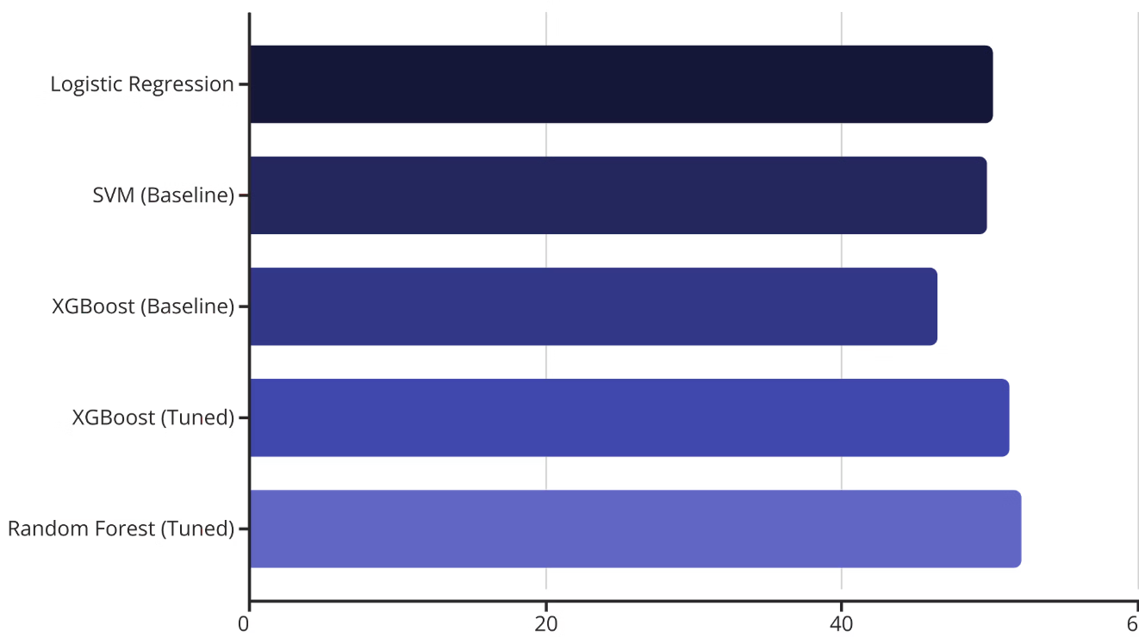
Results: The Efficient Market Reality
Model Performance Comparison
Performance Metrics Table
Model
Best CV Score
Test Set Accuracy
Logistic Regression
0.5067
0.4939
Random Forest
0.5055
0.5400
XGBoost
0.5133
0.4673
SVM
0.5152
0.4625
Statistical Interpretation
Key Observations
Accuracy near 50% aligns with the Efficient Market Hypothesis.
Random Forest achieved the highest test accuracy at 54.00%.
A 2-4% edge over random chance is statistically significant but practically limited.
All models clustered around 50-51% CV scores, indicating market efficiency.
Results validate that cryptocurrency markets rapidly incorporate sentiment information.
Performance suggests sentiment alone provides marginal predictive power.

Slide 17
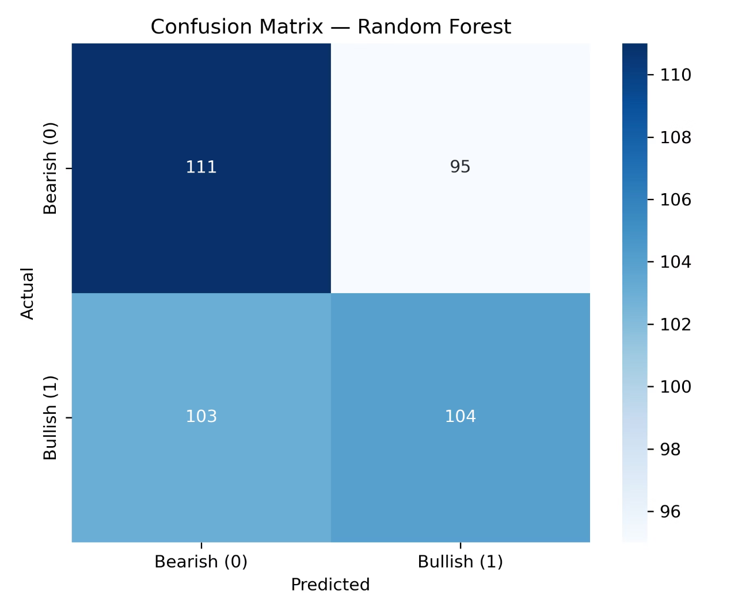
Confusion Matrix Analysis
Performance Breakdown
While 52% accuracy appears underwhelming, context matters. In high-frequency trading, a 2% edge over random chance represents statistical significance.
Our tuned Random Forest model demonstrated slight asymmetry in prediction accuracy, performing marginally better at identifying bullish trends compared to bearish movements.
However, this edge is insufficient as a standalone trading strategy without additional signals, risk management, and transaction cost considerations.
Key Metrics
True Positives: Correctly identified upward movements
False Negatives: Missed bullish opportunities
Precision/Recall: Balanced but modest scores

Slide 18
Why Not 90% Accuracy?
Our model's predictive accuracy, while statistically significant, did not reach the high percentages often desired. This outcome highlights fundamental realities of financial markets and inherent machine learning limitations.
Data Limitation
Market Stochasticity
Sentiment as a "Weak Learner"
A dataset of 2,000 rows is considerably small for training robust machine learning models, especially in complex and dynamic domains like financial markets. More extensive data would likely improve model generalization and performance.
Financial markets are inherently stochastic and non-deterministic. The pursuit of a "Holy Grail" of 90% predictable returns is a fallacy; markets are designed to be efficient, making consistent high predictability extremely difficult.
While relevant, sentiment data often acts as a "weak learner" feature. It provides a signal, but it's just one piece of a much larger, noisy puzzle of market drivers, making it insufficient for high-accuracy predictions on its own.
Our results implicitly validate the Efficient Market Hypothesis: sentiment is rapidly incorporated into prices, and predicting crypto markets with simple data is profoundly challenging. The high 'noise' in crypto requires far more sophisticated approaches.

Slide 19


Conclusion & Future Directions
Key Findings
Future Research Directions
Methodology Contributions & Closing
Marginal Predictive Edge: Sentiment analysis provides a 2.1% advantage over random guessing—statistically significant but insufficient as a standalone strategy.
LSTM Time-Series Models: Incorporate temporal dependencies and momentum indicators to analyze price trends over sequential time windows rather than isolated snapshots.
Successfully constructed a robust, professional ML pipeline handling complex financial data with proper preprocessing and validation.
Theoretical Validation: Results empirically support market efficiency theory in cryptocurrency markets.
Natural Language Processing: Process raw social media content (tweets, Reddit posts) directly rather than relying on pre-aggregated sentiment scores, potentially capturing nuanced signals.
Thank you. We welcome your questions and feedback on our methodology and findings.
Hybrid Ensemble Approaches: Combine sentiment models with technical analysis and on-chain metrics for comprehensive multi-signal strategy.

